Slide 1

Government Digital Services (GDS)

Slide 2
What is GDS?
GDS, or Government Digital Service, is a UK organization that designs, builds, and maintains digital products to improve the user experience of government services. Their goal is to make these services simple, non-threatening, and comprehensible for everyone.
They are located in London in England at 10 Whitechapel High Street, London E1 8QS at coordinates 51.51448, -0.072943

Slide 3
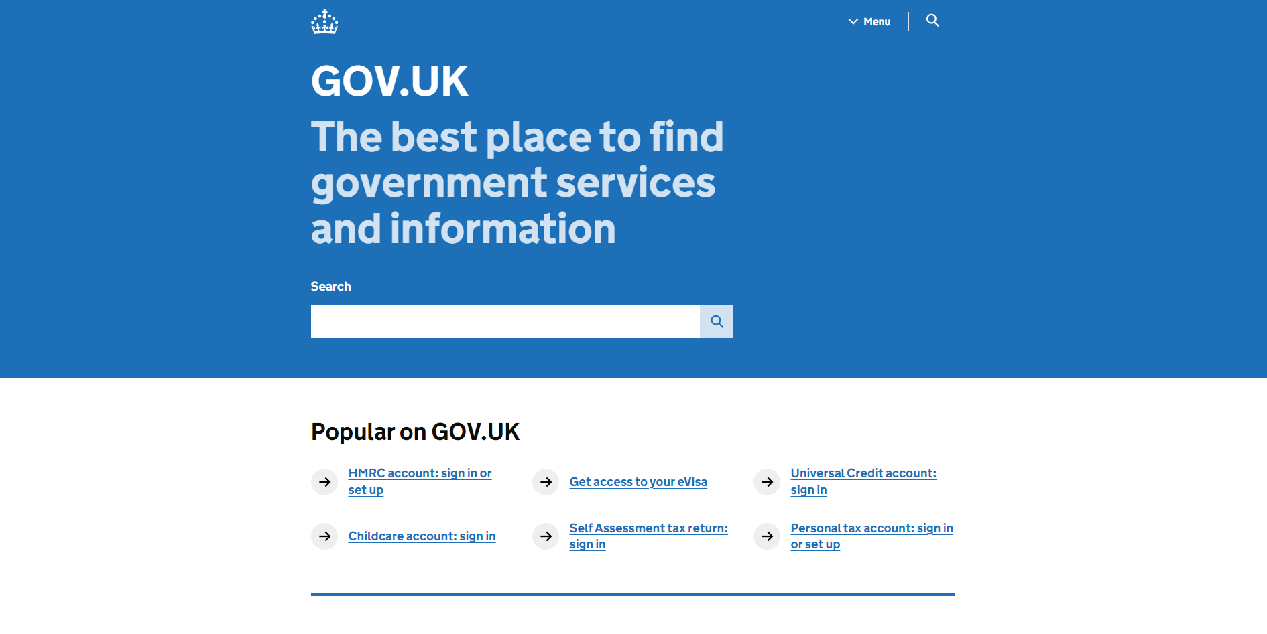
Problems with Gov.UK
There may be issues with Gov.UK such as:
Slow connection
Crashes
The website or servers may be shut down due to reasons such as maintenance or technical issues
Some users may find it hard to navigate the UI to find information
It does not include easily accessible links to useful websites
User interface problems:
Large amount of screen space wasted.
Search bar is not always accessible on screen.
When opening the website, it does not give any information and only has links to popular searches.
My personal problems with it:
Unnecessary use of the website name such as saying popular on GOV.UK rather than popular.
Use of a search button and a search bar in different places but both are only at the top of the page and can't be accessed when scrolling down the page.

Slide 4

Positives about GOV.UK
Positives about Gov.UK are:
Its large database of information
Its use of mainly two colours (blue and white)
Its use of a menu to switch between different pages of information rather than all information being on the home page
The ability to sort and filter on searches
Logo shows the name of the website and its relation to the government

Slide 5
Solutions to the problems
Slow connection – provide a website with either better bandwidth or with multiple of the website hosted at different locations
Crashes – have a minimal server with basic uses to keep computer resources low so that more people can be using the server at once
Website shutdown/ maintenance – have a my website show basic information and is run separately to gov.uk not requiring maintenance or shut down as it is simple and is not complex enough for bugs to occur
Hard to navigate UI – make user interface easier to understand for users by being simple and intuitive in some way
Include links to useful websites
Try to avoid wasting screen space

Slide 6
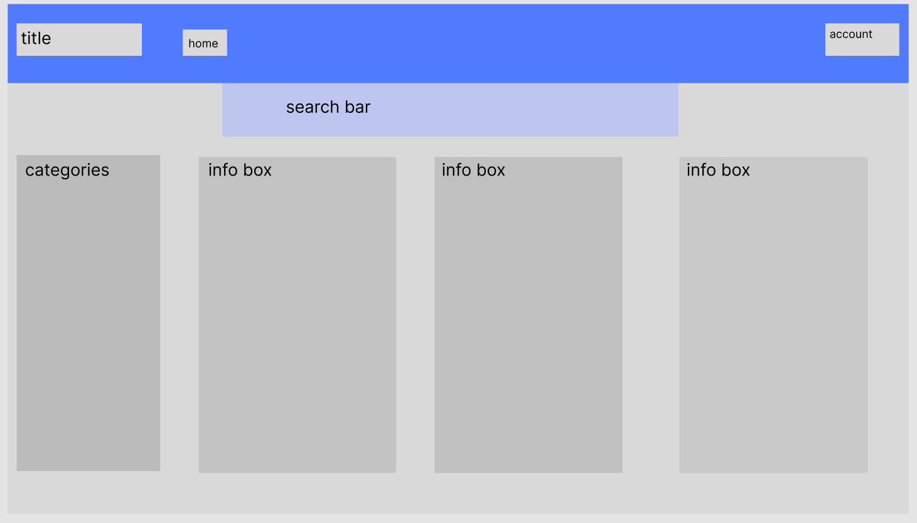
Design idea for website

Slide 7
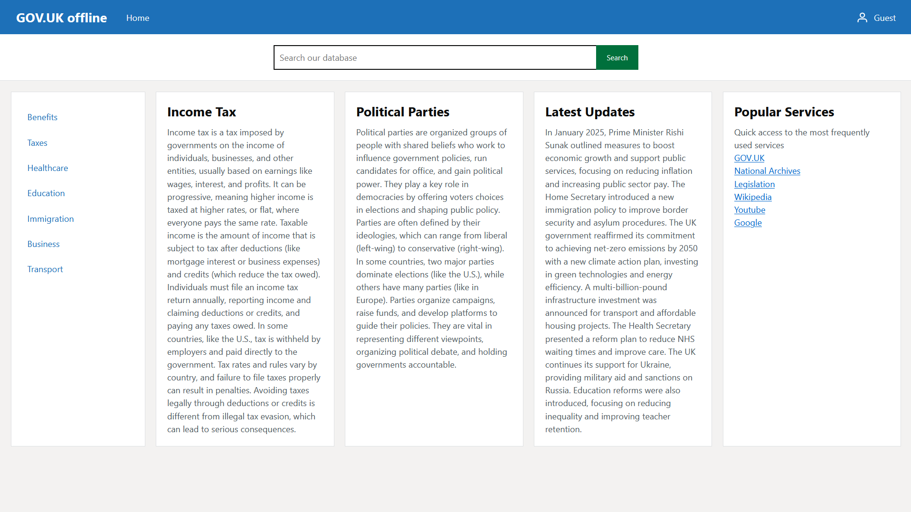
The website prototype

Slide 8

What I would do with more time
If I had more time I would:
Add ai integration
connect info and text directly to the gov.uk database so it is all accessed through my website rather than by searching and connecting to the gov.uk website
Spend more time on the design and colours of the website

